Slide 1
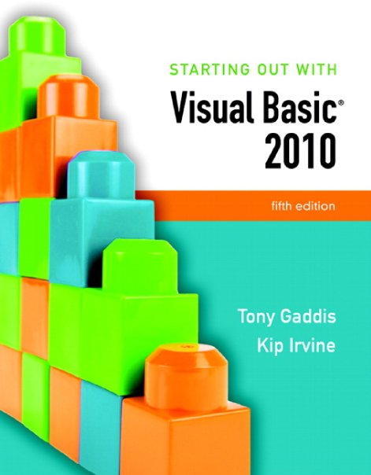

Slide 2
Chapter 12
Classes, Collections,
and Inheritance

Slide 3
Introduction
This chapter introduces:
Abstract Data Types
How to create them with classes
The process of analyzing a problem
Determining its classes
Techniques
For creating objects, properties, and methods
The Object Browser
Provides information about classes in your project
Collections
Structures for holding groups of objects
Inheritance
A way for new classes to be created from existing ones

Slide 4
Classes and Objects
Section 12.1
Classes are program structures that define abstract data types and
are used to create objects.

Slide 5
Object-Oriented Programming
Object-oriented programming (OOP) is a way of designing and coding applications with interchangeable software components that can be used to build larger programs
First languages appeared in the 1980’s
SmallTalk, C++, and ALGOL
The legacy of these languages has been the gradual development of object-like visual tools for building programs
In Visual Basic, forms, buttons, check boxes, list boxes and other controls are all examples of objects
These designs help produce programs that are well suited for ongoing development and expansion

Slide 6
Abstract Data Types
An abstract data type (ADT) is a data type created by a programmer
ADTs are important in computer science and object-oriented programming
An abstraction is a model of something that includes only its general characteristics
Dog is a good example of an abstraction
Defines a general type of animal but not a specific breed, color, or size
A dog is like a data type
A specific dog is an instance of the data type

Slide 7
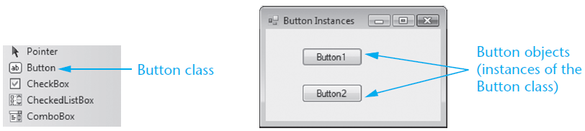
Classes
A class is a program structure that defines an abstract data type
Create the class first
Then create an instance of the class
also called an object
Class instances share common characteristics
Visual Basic forms and controls are classes

Slide 8
Class Properties, Methods, and Event Procedures
Programs communicate with an object using the properties and methods of the class
Class properties:
Buttons have Location, Text, and Name properties
Class methods:
The Focus method functions identically for every single button
Class event procedures:
Each button on a form has a different click event procedure

Slide 9
Object-Oriented Design
The challenge is to design classes that effectively cooperate and communicate
Analyze application requirements to determine ADTs that best implement the specifications
Classes are fundamental building blocks
Typically represent nouns of some type
A well-designed class may outlive the application
Other uses for the class may be found

Slide 10
Finding the Classes
Object-oriented analysis starts with a detailed specification of the problem to be solved
A term often applied to this process is finding the classes
For example, specifications for a program that involves scheduling college classes for students:
Notice the italicized nouns and noun phrases:
List of students, transcript, student, and course
These would ordinarily become classes in the program’s design
We need to keep a list of students that lets us track the courses they have completed. Each student has a transcript that contains all information about his or her completed courses. At the end of each semester, we will calculate the grade point average of each student. At times, users will search for a particular course taken by a student.

Slide 11
Looking for Control Structures
Classes can also be discovered in
The description of processing done by the application
The description of control structures
For example, a description of the scheduling process:
A controlling agent could be implemented with a class
For example, a class called Scheduler
Can be used to match each student’s schedule with the college’s master schedule
We also want to schedule classes for students, using the college’s master schedule to determine the times and room numbers for each student’s class. When the optimal arrangement of classes for each student has been determined, each student’s class schedule will be printed and distributed.

Slide 12
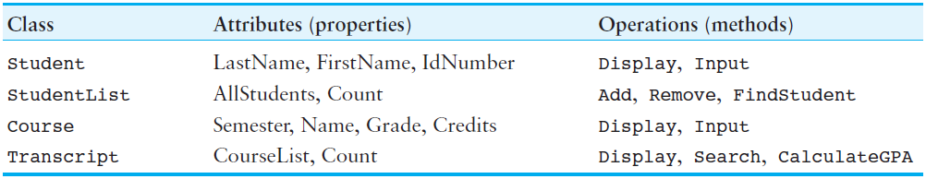
Describing the Classes
The next step is to describe classes in terms of attributes and operations
Attributes are implemented as properties
Characteristics of each object
Describe the common properties of class objects
Operations are implemented as methods
Actions the class objects perform
Messages they can respond to

Slide 13
Interface and Implementation
The class interface is the portion of the class that is visible to the programmer
The client program is written to use a class
Refers to the client-server relationship between a class and the programs that use it
The class implementation is the portion of the class that is hidden from client programs
Created from private member variables, properties, and methods
The hiding of data and procedures in a class is achieved through a process called encapsulation
Visualize the class as a capsule around its data and procedures

Slide 14
Creating a Class
Section 12.2
To create a class in Visual Basic, you create a class declaration.
The class declaration specifies the member variables, properties,
methods, and events that belong to the class.

Slide 15
Class Declaration and Adding a Class
You create a class in Visual Basic with a class declaration using the following general format:
ClassName is the name of the class
MemberDeclarations are the declarations for all the variables, constants, and methods that will belong to the class
To add a class declaration to a Windows application project:
Click Project on the menu bar, the click Add Class
Change the default name that appears in the Name text box
Click the Add button on the Add New Item dialog box
Public Class ClassName
MemberDeclarations
End Class

Slide 16
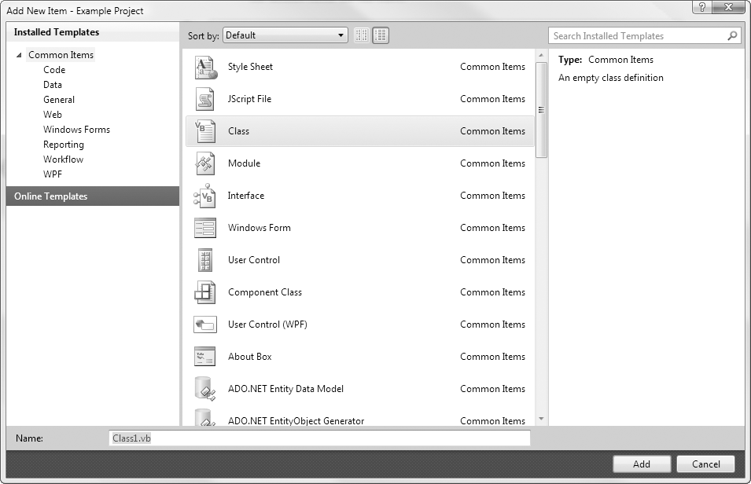
The Add New Item Dialog Box

Slide 17
Member Variables
A member variable is a variable that is declared inside a class declaration using the following general format:
AccessSpecifier determines the accessibility of the variable
Public access outside of the class or assembly
Friend access only by other classes inside the same assembly
Private access only by statements inside the class declaration
VariableName is the name of the variable
DataType is the variable’s data type
As with structures, a class declaration does not create an instance of the class
To work with a class, you must create class objects, which are instances of the class
AccessSpecifer VariableName As DataType

Slide 18
Creating an Instance of a Class
A two-step process creates an instance of a class
Declare a variable whose type is the class
Create instance of the class with New keyword and assign the instance to the variable
Or you can accomplish both steps in one statement
Dim freshman As Student
freshman = New Student
Dim freshman As New Student

Slide 19
Accessing Members
Once created, you can work with a class object’s Public members in code
Access the Public members with the dot (.) operator
Suppose the Student class was declared as follows:
The following assigns values to each of the member variables for an instance of the Student class named freshman:
Public Class Student
Public strLastName As String
Public strFirstName As String
Public strId As String
End Class
' Assign values to the object's members.
freshman.strFirstName = "Joy"
freshman.strLastName = "Robinson"
freshman.strId = "23G794"

Slide 20
Property Procedures
A property procedure is a function that defines a class property using the following general format:
PropertyName is the name of the property procedure
DataType is the type of data that can be assigned to the property
The Get section holds the code that executes when the value is retrieved
The Set section hold the code that executes when the value is stored
Public Property PropertyName() As DataType
Get
Statements
End Get
Set(ParameterDeclaration)
Statements
End Set
End Property

Slide 21
Example Class Property
Public Class Student
Private strLastName As String ' Holds last name
Private strFirstName As String ' Holds first name
Private strId As String ' Holds ID number
Private dblTestAverage As Double ' Holds test average
Public Property TestAverage() As Double
Get
Return dblTestAverage
End Get
Set(ByVal value As Double)
dblTestAverage = value
End Set
End Property

Slide 22
Example Class Property Use
Stores the value 82.3 in the TestAverage property using the Set section of the property procedure
Any statement that retrieves the value in the TestAverage property causes the Get section of the property procedure to execute
Dim freshman As New Student
freshman.TestAverage = 82.3
dblAverage = freshman.TestAverage
MessageBox.Show(freshman.TestAverage.ToString())

Slide 23
Read-Only Properties
Client programs can query a read-only property and get is value, but cannot modify it
Here is the general format of a read-only property procedure:
Uses the ReadOnly keword
Has no Set section
Only capable of returning a value
Public ReadOnly Property PropertyName() As DataType
Get
Statements
End Get
End Property

Slide 24
Read-Only Property Example
Public ReadOnly Property Grade() As String
Get
Dim strGrade As String
If dblTestAverage >= 90.0 Then
strGrade = "A"
ElseIf dblTestAverage >= 80.0 Then
strGrade = "B"
ElseIf dblTestAverage >= 70.0 Then
strGrade = "C"
ElseIf dblTestAverage >= 60.0 Then
strGrade = "D"
Else
strGrade = "F"
End If
Return strGrade
End Get
End Property

Slide 25
Removing Objects and Garbage Collection
Memory space is consumed when objects are instantiated
Objects no longer needed should be removed
Set object variable to Nothing so it no longer references the object
Object is a candidate for garbage collection when it is no longer referenced by any object variable
The garbage collector monitors for and automatically destroys objects no longer needed
freshman = Nothing

Slide 26
Going Out of Scope
An object variable is local to the procedure in which it is declared
Will be removed from memory when the procedure ends
This is called going out of scope
The object variable will not be removed from memory if it is referenced by a variable that is outside of the procedure
Sub CreateStudent()
Dim sophomore As New Student ' Create an instance of the Student class.
' Assign values to its properties.
sophomore.FirstName = "Travis"
sophomore.LastName = "Barnes"
sophomore.IdNumber = "17H495"
sophomore.TestAverage = 94.7
g_studentVar = sophomore ' Assign the object to a global variable.
End Sub

Slide 27
Comparing Object Variables with the Is and IsNot Operators
The Is operator determines if two variables reference the same object
The IsNot operator determines if two variables do not reference the same object
The special value Nothing determines if the variable references any object
If collegeStudent Is transferStudent Then
' Perform some action
End If
If collegeStudent IsNot transferStudent Then
' Perform some action
End If
If collegeStudent Is Nothing Then
' Perform some action
End If
If transferStudent IsNot Nothing Then
' Perform some action
End If

Slide 28
Creating an Array of Objects
You can create an array of object variables
Then create an object for each element to reference
Use another loop to release the memory used by the array
Dim mathStudents(9) As Student
Dim intCount As Integer
For intCount = 0 To 9
mathStudents(intCount) = New Student
Next
Dim intCount As Integer
For intCount = 0 To 9
mathStudents(intCount) = Nothing
Next

Slide 29
Writing Procedures and Functions That Work with Objects
Can use object variables as arguments to a procedure or function
Example: student object s as an argument
Pass object variable with the procedure call
Sub DisplayStudentGrade(ByVal s As Student)
' Displays a student's grade.
MessageBox.Show("The grade for " & s.FirstName &
" " & s.LastName & " is " &
s.TestGrade.ToString())
End Sub
DisplayStudentGrade(freshman)

Slide 30
Passing Objects by Value and by Reference
If argument is declared using ByRef
Values of object properties may be changed
The original object variable may be assigned to a different object
If argument is declared using ByVal
Values of object properties may be changed
The original object variable may not be assigned to a different object

Slide 31
Returning an Object from a Function
Example below instantiates a student object
Prompts the user for and sets its property values
Then returns the instantiated object
Dim freshman As Student = GetStudent()
Function GetStudent() As Student
Dim s As New Student
s.FirstName = InputBox("Enter the student's first name.")
s.LastName = InputBox("Enter the student's last name.")
s.IdNumber = InputBox("Enter the student's ID number.")
s.TestAverage = CDbl(InputBox("Enter the student's test average."))
Return s
End Function

Slide 32
Methods
Public Class Student
' Member variables
Private strLastName As String
Private strFirstName As String
Private strId As String
Private dblTestAverage As Double
(...Property procedures omitted...)
' Clear method
Public Sub Clear()
strFirstName = String.Empty
strLastName = String.Empty
strId = String.Empty
dblTestAverage = 0.0
End Sub
End Class
A method is a procedure or function that is a member of a class
Performs some operation on the data stored in the class
For example, the following statement calls the Clear method of the Student object freshman
freshman.Clear()

Slide 33
Constructors
A constructor is a method that is automatically called when an instance of the class is created
Think of constructors as initialization routines
Useful for initializing member variables or other startup operations
To create a constructor:
Create a method named New inside the class
Alternatively, select New from the method name drop-down list
Public Class Student
' Member variables
Private strLastName As String
Private strFirstName As String
Private strId As String
Private dblTestAverage As Double
' Constructor
Public Sub New()
strFirstName = "(unknown)"
strLastName = "(unknown)"
strId = "(unknown)"
dblTestAverage = 0.0
End Sub
(The rest of this class is omitted.)
End Class

Slide 34
Finalizers
A finalizer is a class method named Finalize
Automatically called just before an instance of the class is removed from memory
To create a Finalize method:
Select Finalize from the method name drop-down list
The following code template is created for you:
Protected Overrides Sub Finalize()
MyBase.Finalize()
' Perform some action
End Sub

Slide 35
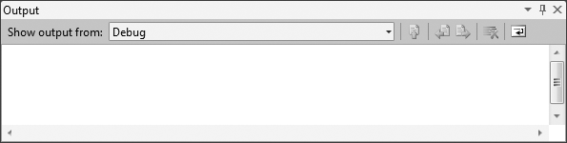
Displaying Messages in the Output Window
The Output window is a valuable debugging tool
Display it by clicking the View menu, Other Windows, then Output or you can press the Ctrl + Alt + O key combination
Display your own messages with the Debug.WriteLine method using the following general format:
Enable debug messages by inserting the following in your startup form’s Load event handler:
Debug.WriteLine(Output)
Debug.Listeners.Add(New ConsoleTraceListener())

Slide 36
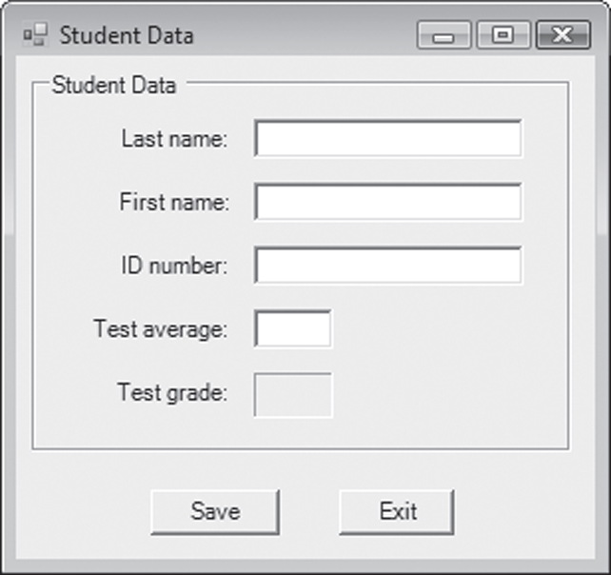
Tutorial 12-1
You create the Student class
An application that saves student data to a file
Display messages in the output window

Slide 37
Collections
Section 12.3
A collection holds a group of items. It automatically expands and
shrinks in size to accommodate the items added to it. It allows
items to be stored with associated key values, which may then be
used in searches.

Slide 38
Collections
A collection is similar to an array
A single unit that contains several items
Access individual items with an index value
Differences from an array include the following:
Collections index values begin at 1
Collections automatically expand as items are added and shrink as items are removed
Items in a collection do not have to be of the same data type

Slide 39
Creating an Instance of the Collection Class
Visual Basic provides a class named Collection
To create an instance of the Collection class:
Declare a variable whose type is the Collection class
Create instance of the class with New keyword and assign the instance to the variable
Or you can accomplish both steps in one statement
Dim customers As Collection
customers = New Collection
Dim customers As New Collection

Slide 40
Adding Items to a Collection
You add items to a collection with the Add method using the following general format:
CollectionName is the name of an object variable that references a collection
Item is the object, variable, or value that is to be added to the collection
Key is an optional string expression that can be used to search for items
Must be unique for each member of a collection
CollectionName.Add(Item [, Key])

Slide 41
Examples of Adding Items to a Collection
Declaring a Collection object
Inserting a value into the collection
Inserting a value into the collection with an optional key value
Handling duplicate key exceptions
Private customers As New Collection
customers.Add(myCustomer)
customers.Add(myCustomer, myCustomer.Name)
Try
customers.Add(myCustomer, myCustomer.Name)
Catch ex as ArgumentException
MessageBox.Show(ex.Message)
End Try

Slide 42
Accessing Items by their Indexes
You can access an item in a collection by passing an integer to the Item method as follows:
CollectionName is the name of the collection object variable
index is the integer index of the item that you want to retrieve
The Item method returns an Object
Call the Ctype method to cast the Object to the type needed
Item is the default method for collections, so you can use an abbreviated format, as in the following example:
CollectionName.Item(index)
Dim cust As Customer = CType(customers.Item(1), Customer)
MessageBox.Show("Customer found: " & cust.Name & ": "& cust.Phone)
Dim cust As Customer = CType(customers(3), Customer)

Slide 43
The IndexOutOfRange Exception
An IndexOutOfRange exception occurs if an index is used that does not match any item in a collection
The following code example shows how to handle the exception:
Try
Dim cust As Customer
Dim index As Integer = CInt(txtIndex.Text)
cust = CType(customers.Item(index), Customer)
MessageBox.Show("Customer found: " & cust.Name & ": " & cust.Phone)
Catch ex As IndexOutOfRangeException
MessageBox.Show(ex.Message)
End Try

Slide 44
The Count Property
Each collection has a Count property
Holds the number of items in the collection
The following code example:
Uses a For Next loop
With the Count property as the upper limit
To add the contents of the collection to a list box
Dim intX As Integer
For intX = 1 To names.Count
lstNames.Items.Add(names(intX).ToString())
Next

Slide 45
Searching for an Item by Key Value Using the Item Method
The Item method can be used to retrieve an item with a specific key value using the following general format:
CollectionName is the name of a collection
Expression can be a numeric or string expression
If a string expression is used
The key value that matches the string is returned
If a numeric expression is used, it becomes the index value
The member at the specified index is returned
If no member exists with an index or key value matching Expression, an IndexOutOfRange exception occurs
CollectionName.Item(Expression)
Dim s As Student = CType(studentCollection.Item("49812"), Student)

Slide 46
Using References versus Copies
When an item in a collection is:
A fundamental Visual Basic Type
Integer, String, Decimal, and so on
Only a copy of the member is returned
its value cannot be changed
A class object
A reference to the object is returned
Its value can be changed

Slide 47
Using the For Each…Next Loop with a Collection
You may use the For Each…Next loop to access the individual members of a collection
Eliminates the need for a counter variable
For example:
Dim s As Student
For Each s In studentCollection
MessageBox.Show(s.LastName)
Next

Slide 48
Removing Members
Use the Remove method to remove a member from a collection using the following general format:
CollectionName is the name of a collection
Expression can be a numeric or string expression
If a string expression is used
The key value that matches the string is removed
An ArgumentExeception occurs if the key value does not match an item in the collection
If a numeric expression is used, it becomes the index value
The member at the specified index is removed
An IndexOutOfRange exception occurs if the index does not match any item in the collection
CollectionName.Remove(Expression)

Slide 49
Preventing Exceptions when Removing Members
To avoid throwing an exception with the Remove method:
Always check the range of the index
Make sure a key value exists before using it
Dim intIndex As Integer
' (assign value to intIndex...)
If intIndex > 0 and intIndex <= studentCollection.Count Then
studentCollection.Remove(intIndex)
End If
Dim strKeyToRemove As String
' (assign value to strKeyToRemove...)
If studentCollection.Contains(strKeyToRemove) Then
studentCollection.Remove(strKeyToRemove))
End If

Slide 50
Writing Sub Procedures and Functions That Use Collections
Sub procedures and functions can accept collections as arguments
Remember that a collection is an instance of a class
Follow the same guidelines for:
Passing a class object as an argument
Returning a class object from a function

Slide 51
Relating the Items in Parallel Collections
Sometimes it is useful to store related data in two or more parallel collections
Use a unique key value to relate the items in the collections
An ID or employee number for instance
For example, the following code works with items in parallel collections by using the employee number 55678 as the key value
Dim hoursWorked As New Collection ' To hold hours worked
Dim payRates As New Collection ' To hold hourly pay rates
hoursWorked.Add(40, "55678") ' Store a value using the key value
payRates.Add(12.5, "55678") ' Use the same key value again
' The key value is used once again when retrieving the related data
sngGrossPay = hoursWorked.Item("55678") * payRate.Item("55678")

Slide 52
Focus on Problem Solving: Creating the Student Collection Application
Section 12.4
Create the Student Collection application

Slide 53
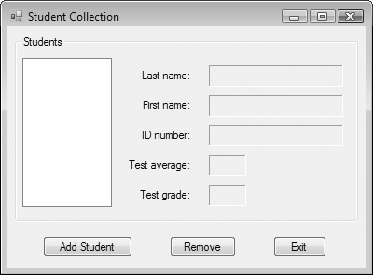
The MainForm Form
Displays a list of student ID numbers in the list box
When an ID number is selected, student data is displayed in the labels
The Add Student button causes the AddForm form to be displayed
The Remove button removes a student with the currently selected ID number

Slide 54
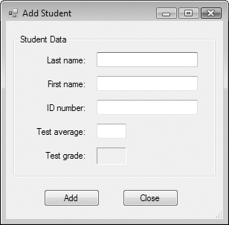
The AddForm Form
Allows the user to enter student data in the text boxes
The Add button adds the student data to the collections

Slide 55
The Object Browser
Section 12.5
The Object Browser is a dialog box that allows you to browse all
classes and components available to your project.

Slide 56
The Object Browser
The Object Browser is a dialog box that displays information about objects
You can use the object browser to examine:
Classes you have created in your project
Namespaces, classes, and other components that Visual Basic makes available to your project
Tutorial 12-3 guides you through the process of using the Object browser to examine the classes you created in the Student Collection project

Slide 57
Introduction to Inheritance
Section 12.6
Inheritance allows a new class to be based on an existing class. The
new class inherits the accessible member variables, methods, and
properties of the class on which it is based.

Slide 58
What is Inheritance?
Inheritance allows new classes to derive their characteristics from existing classes
The Student class may have several types of students such as
GraduateStudent
ExchangeStudent
StudentEmployee
These can become new classes and share all the characteristics of the Student class
Each new class would then add specialized characteristics that differentiate them

Slide 59
Base and Derived Classes
The Base Class is a general-purpose class that other classes may be based on
Think of the base class as a parent
A Derived Class is based on the base class and inherits characteristics from it
Think of the derived class as a child

Slide 60
The Vehicle Base Class
Consider a Vehicle class with the following:
Private variable for number of passengers
Private variable for miles per gallon
Public property for number of passengers (Passengers)
Public property for miles per gallon (MilesPerGallon)
This class holds general data about a vehicle
Can create more specialized classes from the Vehicle class

Slide 61
The Truck Derived Class
Truck class derived from Vehicle class
Inherits all non-private methods, properties, and variables of Vehicle class
Truck class defines two properties of its own
MaxCargoWeight – holds top cargo weight
FourWheelDrive – indicates if truck is 4WD
The Vehicle Inheritance program in the Chapter 12 student sample programs folder contains the code for the Vehicle and Truck classes

Slide 62
Overriding Properties and Methods
Sometimes a base class property procedure or method must work differently for a derived class
You can override base class method or property
You must write the method or property as desired in the derived class using same name
When an object of the derived class accesses the property or calls the method
The overridden version in derived class is used
The base class version is not used

Slide 63
Overriding Procedure Example
Vehicle class has no restriction on number of passengers
But may wish to restrict the Truck class to two passengers at most
Can override Vehicle class Passengers property by:
Coding Passengers property in derived class
Specify Overridable keyword in base class property
Specify Overrides keyword in derived class property

Slide 64
Overridable Property Procedure in the Base Class Example
Overridable keyword added to Vehicle base class property procedure
Public Overridable Property Passengers() As Integer
Get
Return intPassengers
End Get
Set(ByVal value As Integer)
intPassengers = value
End Set
End Property

Slide 65
Overridden Property Procedure in the Derived Class Example
Overrides keyword and new logic added to Truck derived class property procedure
The MyBase keyword refers to the base class
Public Overrides Property Passengers() As Integer
Get
Return MyBase.Passengers
End Get
Set(ByVal value As Integer)
If value >= 1 And value <= 2 Then
MyBase.Passengers = value
Else
MessageBox.Show("Passengers must be 1 or 2.", "Error")
End If
End Set
End Property

Slide 66
Overriding Methods
The general format of a procedure that overrides a base class procedure is as follows:
The general format of a function that overrides a base class function is as follows:
When overriding methods and procedures, remember that:
A derived class cannot access methods or property procedures in the base class that are declared as Private
A derived class must keep the same access level as the base class
AccessSpecifier Overrides Sub ProcedureName()
Statements
End Sub
AccessSpecifier Overrides Function FunctionName() As DataType
Statements
End Sub

Slide 67
Overriding the ToString Method
Every class that you create in Visual Basic is derived from a built-in class named Object
The Object class has a method named ToString
You can override this method so it returns a string representation of the data stored in an object
' Overridden ToString method
Public Overrides Function ToString() As String
' Return a string representation of a vehicle.
Dim str As String
str = "Passengers: " & intPassengers.ToString() &
" MPG: " & dblMPG.ToString()
Return str
End Function

Slide 68
Base Class and Derived Class Constructors
A constructor (named New) may be defined for both the base class and a derived class
When a new object of the derived class is created, both constructors are executed
The constructor of the base class will be called first
Then the constructor of the derived class will be called

Slide 69
Base and Derived Class Constructors Example
Public Class Vehicle
Public Sub New()
MessageBox.Show("This is the base class constructor.")
End Sub
' (other properties and methods...)
End Class
Public Class Truck
Inherits Vehicle
Public Sub New()
MessageBox.Show("This is the derived class constructor.")
End Sub
' (other properties and methods...)
End Class

Slide 70
Protected Members
The Protected access specifier may be used in the declaration of a base class member, such as the following:
Protected base class members are treated as
Public to classes derived from this base
Private to classes not derived from this base
In Tutorial 12-4, you complete an application that uses inheritance
Protected decCost As Decimal

